Slide 1



PROTECTING THE ICF ENTITLEMENT:
THE REAL MEANING OF OLMSTEAD
October 18, 2018
William Choslovsky
Ginsberg Jacobs LLC
300 S. Wacker Dr., Suite 2750
Chicago, IL 60606
(312) 660-2202 - direct
wchoslovsky@ginsbergjacobs.com
www.ginsbergjacobs.com

Slide 2


Slide 3
Our Journey Today:
Around the DD World in 45 Minutes
History
Olmstead
P&A’s
What to Do?

Slide 4

History

Slide 5

History
History
1960’s
“We as a nation have long neglected the mentally ill
and the mentally retarded. This neglect must end…”
-- President John F. Kennedy
1961: President’s Panel on Mental Retardation
1965: Social Security Act establishes the Medicare and Medicaid programs.
1967: The number of residents in large state institutions for people with mental retardation reaches its peak at 194,650.
1967: ICF’s authorized under Medicaid.
Intended to be “less medically oriented and less expensive form of long-term supports.”
ICF’s were the hip alternative to “institutions.”

Slide 6
1970’s
History
1970: Term “developmental disabilities” introduced
and expanded to cover cerebral palsy, epilepsy, and other conditions.
1973: Rehabilitation Act rewritten to cover persons with severe disabilities.
  Section 504 protects DD from discrimination in all federal programs.
1975: Education of all Handicapped Children Act – mandated access to free, appropriate public education for all children regardless of type or severity of disability.
  IEP’s introduced.
  Result: less “kids” placed into ICF’s because could now attend public schools.
1975: The Developmental Disabilities Assistance and Bill of Rights Act (the “DD Act”)
  Established protection & advocacy agencies in each state (“P&A’s”).

Slide 7

History
1980’s
1981: “Waiver” program created!
  Created Section 1915(c) of the Social Security Act
  Intended to reduce the “institutional bias” of the Medicaid program.
1985: First waiver regulations published

Slide 8
History
Waiver Dependent on ICF
By law, the “community” alternative to the ICF entitlement – called a “waiver” – is dependent on a state offering the ICF services. 42 U.S.C. § 1915(c). Waiver services are not an entitlement, meaning states are not required to offer waiver services. Id. As such, a state can provide ICF services without offering waiver services, but it cannot offer waiver services without offering ICF services. Id.

Slide 9
History

Slide 10
History
1990’s
1990: ADA – Americans with Disabilities Act
  Title I: Prohibits discrimination in employment.
  Title II: Public Services
  Title III: Public accommodations by private entities
  Title IV: Telecommunications
1999: Olmstead

Slide 11
2000’s - Present
History
2001: Medicaid funding for people in waivers first exceeds ICF funding.
Today:
  More than 500 waiver programs across the country
  In past 20 years, number of waiver recipients living in their own home has more than doubled
Conclusion: Waiver advocates, you’ve . . .
W O N! 1981: 100% “institutions” | Law of diminishing returns. 2016: 92% waiver

Slide 12
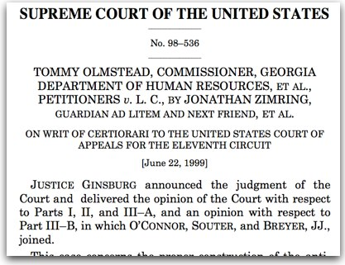
Olmstead

Slide 13
Americans With Disabilities Act: 1990
Olmstead
“Subject to the provisions of this subchapter, no qualified individual with a disability shall, by reason of such disability, be excluded from participation in or be denied the benefits of the services, programs, or activities of a public entity, or be subjected to discrimination by any such entity.”

Slide 14

ADA Regulations
Olmstead
“A public entity shall administer services, programs, and activities in the most integrated setting appropriate to the needs of qualified individuals with disabilities.” 28 CFR § 35.130(d) (1998).
“A public entity shall make reasonable modifications in policies, practices, or procedures when the modifications are necessary to avoid discrimination on the basis of disability, unless the public entity can demonstrate that making the modifications would fundamentally alter the nature of the service, program, or activity.” 28 CFR § 35.130(b)(7) (1998).

Slide 15
Olmstead
The Olmstead Case
Who Were the People: L.C. & E.W.?
L. C. has been diagnosed with schizophrenia, and E. W. with a personality disorder.
Both women have a history of treatment in institutional settings. In May 1992, L. C. was voluntarily admitted to Georgia Regional Hospital at Atlanta (GRH), where she was confined for treatment in a psychiatric unit.
By May 1993, her psychiatric condition had stabilized, and L.C.’s treatment team at GRH agreed that her needs could be met appropriately in one of the community-based programs the State supported.
By 1996, E.W.’s treating psychiatrist concluded that she could be treated appropriately in a community-based setting.

Slide 16
Olmstead
The Olmstead Decision
“Specifically, we confront the question whether the proscription of discrimination may require placement of persons with mental disabilities in community settings rather than in institutions. The answer, we hold, is a qualified yes. Such action is in order when the State’s treatment professionals have determined that:
  community placement is appropriate,
  the transfer from institutional care to a less restrictive setting is not opposed by the affected individual, and
  the placement can be reasonably accommodated, taking into account the resources available to the State and the needs of others with mental disabilities.”
Olmstead v. L.C., 527 U.S. 581 (1999) (Justice Ginsburg)

Slide 17
Olmstead
Olmstead
  In Olmstead, Justice Ginsburg wrote:
  “We emphasize that nothing in the ADA or its implementing regulations condones termination of institutional settings for persons unable to handle or benefit from community settings. . . . Nor is there any federal requirement that community-based treatment be imposed on patients who do not desire it.”
The Olmstead decision interprets public entities’ obligations under Title II of the ADA and the parameters through which qualified individuals with disabilities are not subjected to discrimination, denied benefits, or excluded from participation in services, programs, or activities of a public entity.

Slide 18
Olmstead
Olmstead
In his concurrence, Justice Kennedy warned that:
“It would be unreasonable, it would be a tragic event, then, were the Americans with Disabilities Act of 1990 (ADA) to be interpreted so that States had some incentive, for fear of litigation, to drive those in need of medical care and treatment out of appropriate care and into settings with too little assistance and supervision. . . . In light of these concerns, if the principle of liability announced by the Court is not applied with caution and circumspection, States may be pressured into attempting compliance on the cheap, placing marginal patients into integrated settings devoid of the services and attention necessary for their condition.”

Slide 19
Olmstead
What CMS Says About ICF’s
The Centers for Medicare and Medicaid Services (“CMS”), which is an agency of the United States Department of Health and Human Services (“HHS”), states on its website that:
  States may not limit access to ICF/ID service, or make it subject to waiting lists, as they may for Home and Community Based Services (HCBS). Therefore, in some cases ICF/ID services may be more immediately available than other long-term care options. Many individuals who require
  this level of service have already established disability status and Medicaid eligibility.
“ICF/ID is the most comprehensive benefit in Medicaid” and concludes by stating: “There are few resources like an ICF/ID under any payment source.”

Slide 20

Protection & Advocacy System “P&A’s”

Slide 21

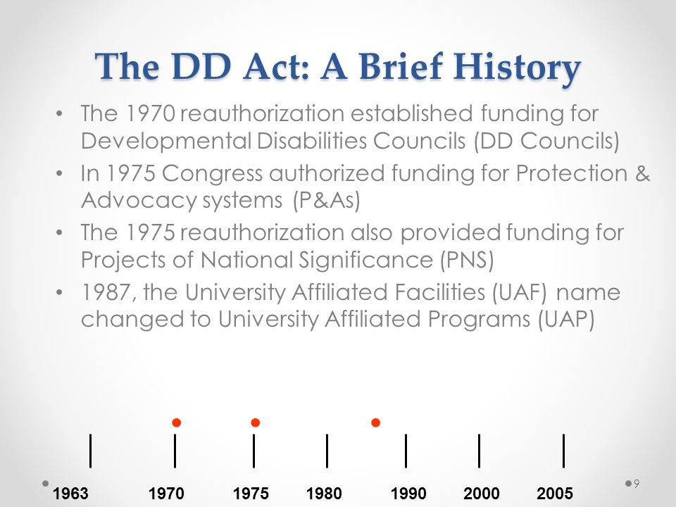
The purpose of the Developmental Disabilities Assistance and Bill of Rights Act of 2000 (DD Act), as described in the current law, is to “assure that individuals with developmental disabilities and their families participate in the design of and have access to needed community services, individualized supports, and other forms of assistance that promote self-determination, independence, productivity, and integration and inclusion in all facets of community life …”

Slide 22
P & A’s
P & A’s
Amongst other things, each state’s P&A is required to:
“ensure the protection of, and advocacy for, the rights of [DD] individuals . . . who are or who may be eligible for treatment, services, or habilitation.” Id. at § 15043(a)(2)(A)(i).
“provide information on and referral to programs and services addressing the needs of individuals with developmental disabilities.” Id. at (ii).
annually submit to HHS a list of “goals and priorities developed through data driven strategic planning.” Id. at (a)(2)(C).
annually allow the public and individuals with DD an opportunity to comment on the P&A’s goals and priorities. Id. at (a)(2)(D).
“establish a grievance procedure for clients or prospective clients of the system to ensure that individuals with developmental disabilities have full access to services of the system.” Id. at (a)(2)(E).

Slide 23
P & A’s
The DD Act also requires that a P&A have a governing board “composed of members who broadly represent . . . the needs of individuals served by the system” Id. at § 15044(a). The majority of its members “shall” be “individuals with disabilities (or their guardians) . . . who are eligible for services . . . through the system.” Id.

Slide 24

What to Do?

Slide 25

Buzz Words
What to Do?
“Institution” vs. “Community”
“Segregate” vs. “Integrate”
VS.
VS.

Slide 26
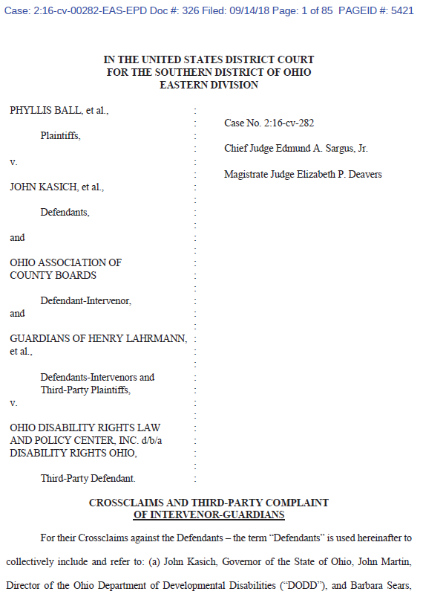


What to Do?
What to Do?
4

Slide 27

Additional Questions?
Call or email with questions:
  wchoslovsky@ginsbergjacobs.com
  312.660.2202

