Slide 1
Addressing the
Adult Autism-I/DD Crisis
by Empowering Nonprofits
by Empowering Essential Care Nonprofits
Jill Escher
Claradon Properties, LLC
Together for Choice Conference • October 18, 2018

Slide 2
Coming soon: ncsautism.org
Pursuing recognition, policy and solutions for the surging population of individuals, families and caregivers affected by severe forms of autism and related disorders.
Educate the public about these disabilities.
Position statements on HCBS, guardianship, vocational options, etc.
Provide a platform for think tanks and serious discourse on policy.
Educate policy makers about our vulnerable population.
Promote research into therapeutics, neurobiology, and causes.
Promote acceptance and awareness of individuals, families, and caregivers affected by severe forms of autism by giving voice to their realities and needs.

Slide 3
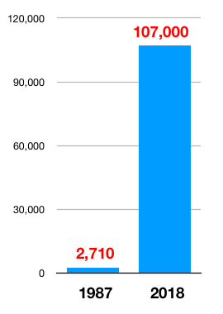
Problem: An explosion of autism
California Dept. of Developmental Services Autism Cases, 1987 v 2018
A 40-fold increase of DD-type autism.
DD-type autism, once rare, is now 40% of the DDS caseload.
The DDS adult autism population will quadruple in the next 20 years.
Autism cases are typically more complex than other eligibility categories.
Demand for services already outstrips capacity.

Slide 4
Problem: Autism parents age and die
Who will care for the unprecedented population of disabled and dependent adults?

Slide 5
Problem: Adult autism is expensive
Representative costs (conservative) for one autistic/DD adult residing outside family home, San Francisco Bay Area, 2018
Home care workers | 120,000
Day program | 40,000
Rent, utilities | 30,000
Transportation | 4,000
Medical/therapies | 10,000
Food, clothing, electronics | 5,000
Recreation | 2,000
Total annual costs | 211,000

Slide 6
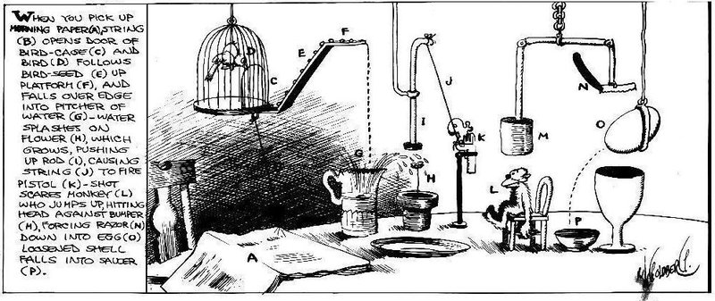
Problem: Our system was not designed for so large and complex an autism/DD population
Medicaid
Social Security
HUD
IHSS
Waitlists, complexity, underfunding, few creative solutions, parent disempowerment, and too much wishful thinking.

Slide 7
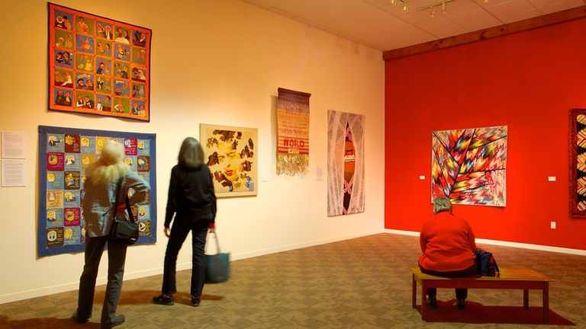
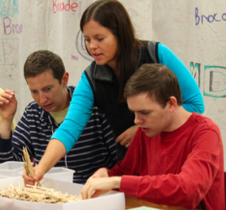
One of these 501(c)(3)s is not like the others
Metropolitan Opera
San Jose Quilt Museum
Buster Keaton Appreciation Society
Morgan Autism Center Adult Program

Slide 8
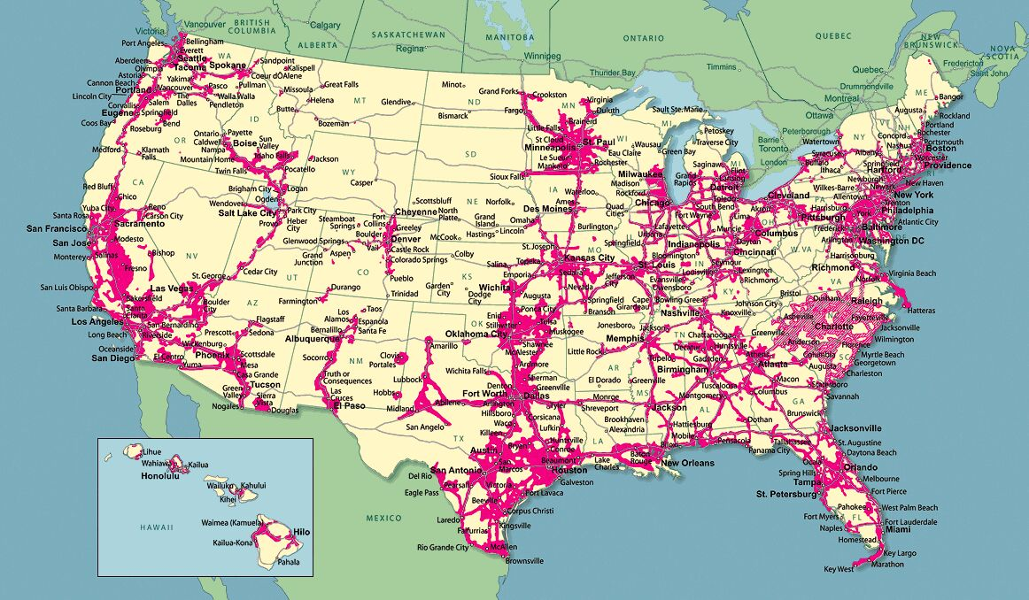
Idea: A new category of nonprofit expressly dedicated to the care of dependent adults with I/DD
Essential Care Nonprofits, IRC 501(c)(?)
Why? We must “grease the wheels” to facilitate creation of a robust network of community-based mission-driven nonprofits serving our most vulnerable.
To address our dire new reality we must change the rules of the nonprofit game.

Slide 9
How to Define an ECN?
ECNs are “lifeboats” providing essential, basic human care services to adults 18+ who meet Medicaid definition of requiring an “institutional level of care” owing to substantial functional and cognitive limitations.
Services could include: aide support, day programs, supported employment programs, housing, medical care, daily living coaching, and behavioral and other forms of therapeutic care.
At least 75% of the organizations' expenditures would be on those direct support activities. Other expenditures could be for overhead or serving the needs of others with other disabilities.
ECNs would have special annual reporting and audit requirements to ensure adherence to IRC rules.

Slide 10
Benefits of ECN Designation
Into this boat could be loaded any number of benefits.
Donor credit instead of donor deduction: Donors eligible for full tax credit up to $50,000/year, as opposed to deductions.
ECNs could feature a special rule allowing family members to create and manage ECNs.
ECNs could carry other benefits: eg, special HUD programs to encourage housing options; government-contracted purchasing rates; tailored Labor and Immigration rules.
ECNs would of course be exempt from federal income taxes.
ECNs could be made exempt from some state and local taxes, including property taxes (big deal in CA).

Slide 11
Politically Feasible?
But this we know for certain: For the lifespan needs of adults with autism or I/DD, failure is not an option.

Slide 12
For more info
ncsautism.org
sfautismsociety.org
jill.escher@gmail.com

