Slide 1
Where do we go from here? Best Practices!
Dr. Crystal Makowski, CRC
Vice President of Special Projects

Slide 2
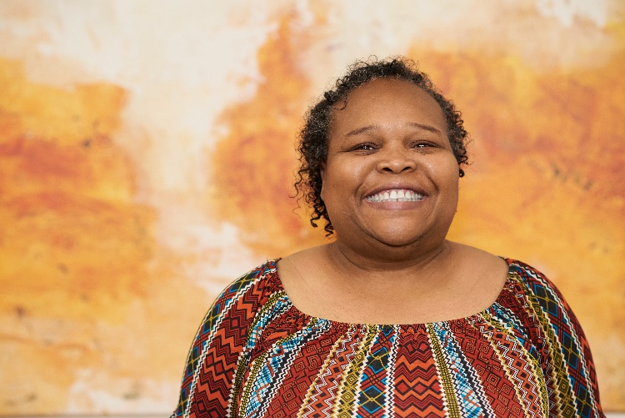
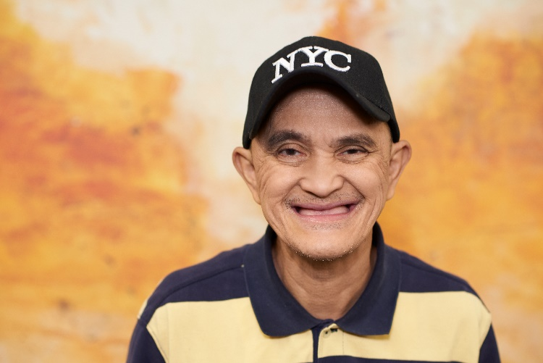
About Us….
Our Mission
is to serve people with intellectual and developmental disabilities to achieve their full potential to participate in community life.
Our Vision
is a community where disability is a distinction without a difference, where individuals will have choices on how they live, learn, work, worship, and play.

Slide 3
About Us….
Our History
The Arc Jacksonville has been championing the inclusion of persons with unique abilities since 1965. Beginning as a grassroots movement to provide educational opportunities, The Arc Jacksonville has been an innovative leader and pioneer of new approaches for 52 years, advocating for and serving individuals and their families.
The Arc Jacksonville serves more than 500 adults each day, helping to answer “What’s Next?” We have continued to grow and evolve along with the changing needs and issues that individuals and their families face.
Agency Video

Slide 4
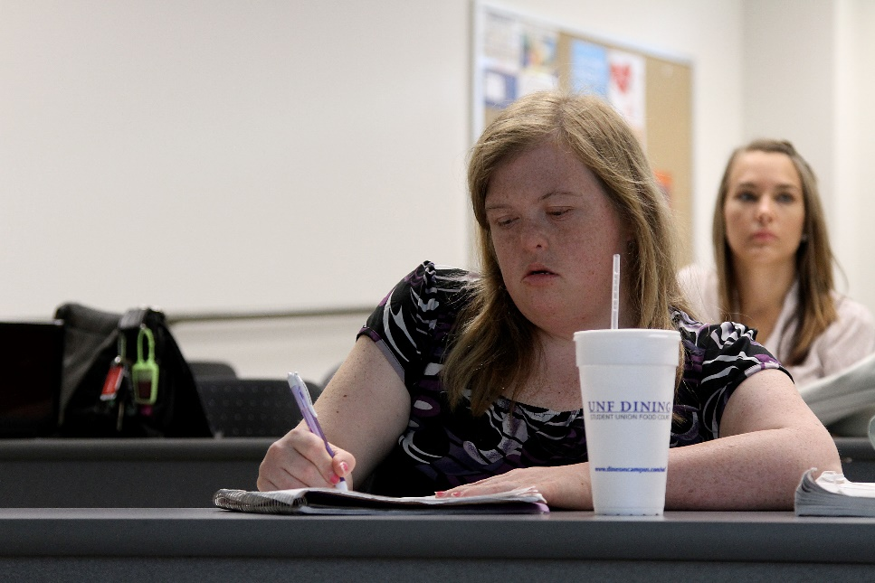
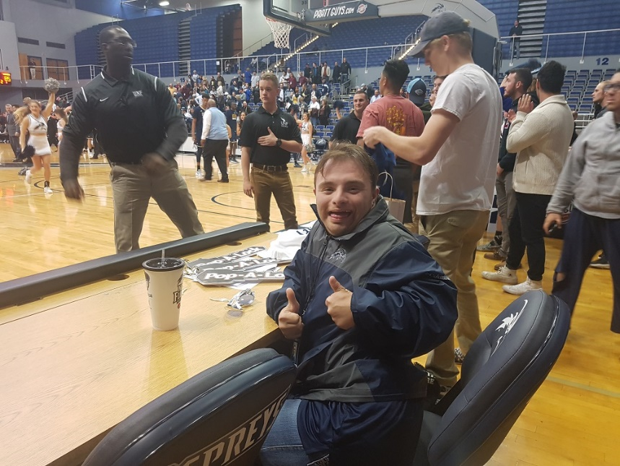
Innovation Explosion…..
The On Campus Transition at the University of North Florida 2006-Present

Slide 5
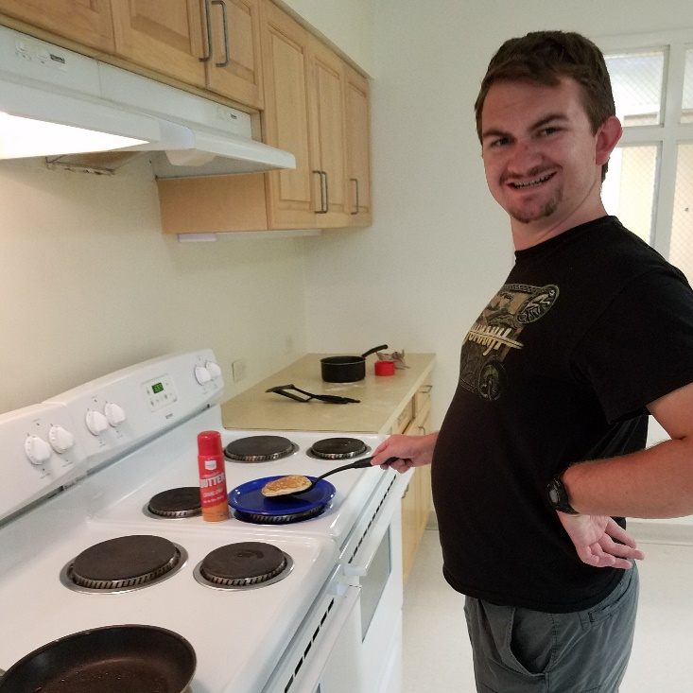
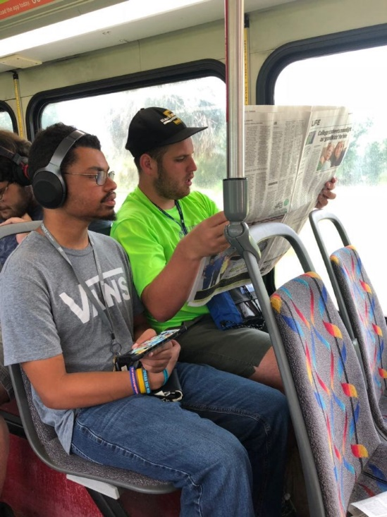
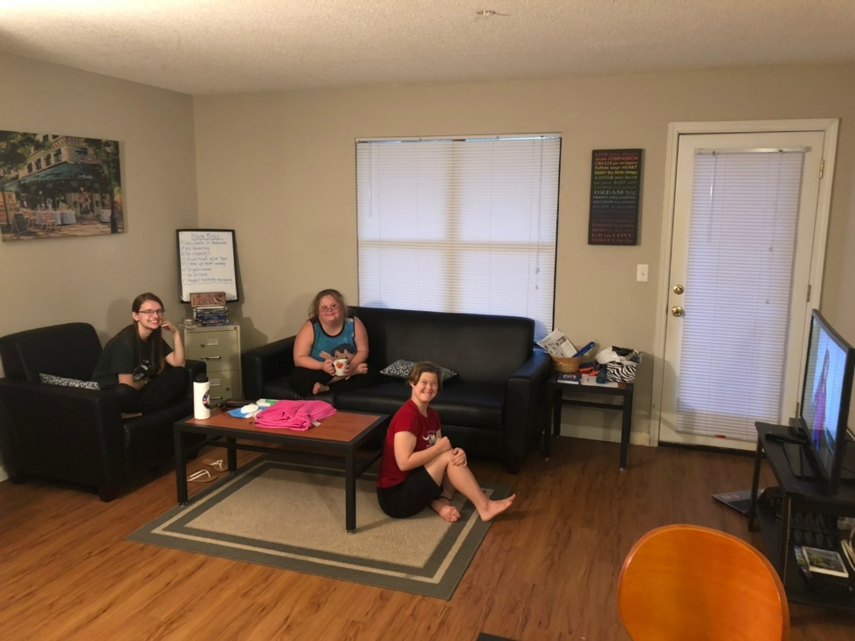
Innovation Explosion…..
On Campus Transition Residential Program & LIFE Experience 2008-Present

Slide 6
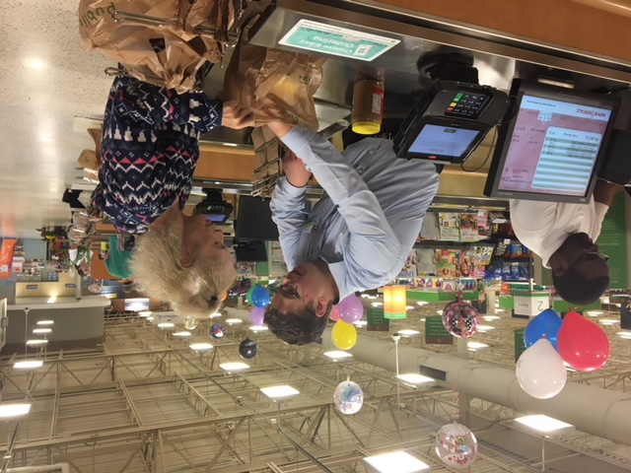
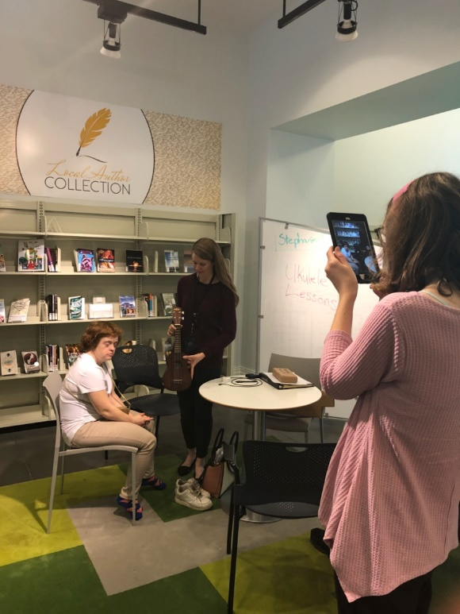
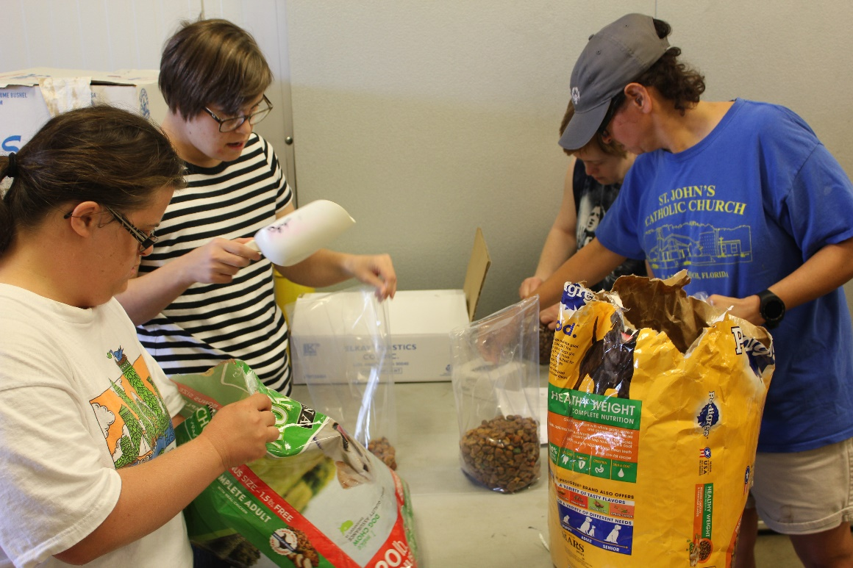
Innovation Explosion…..
Xplore & Public Service Grant 2012-Present

Slide 7
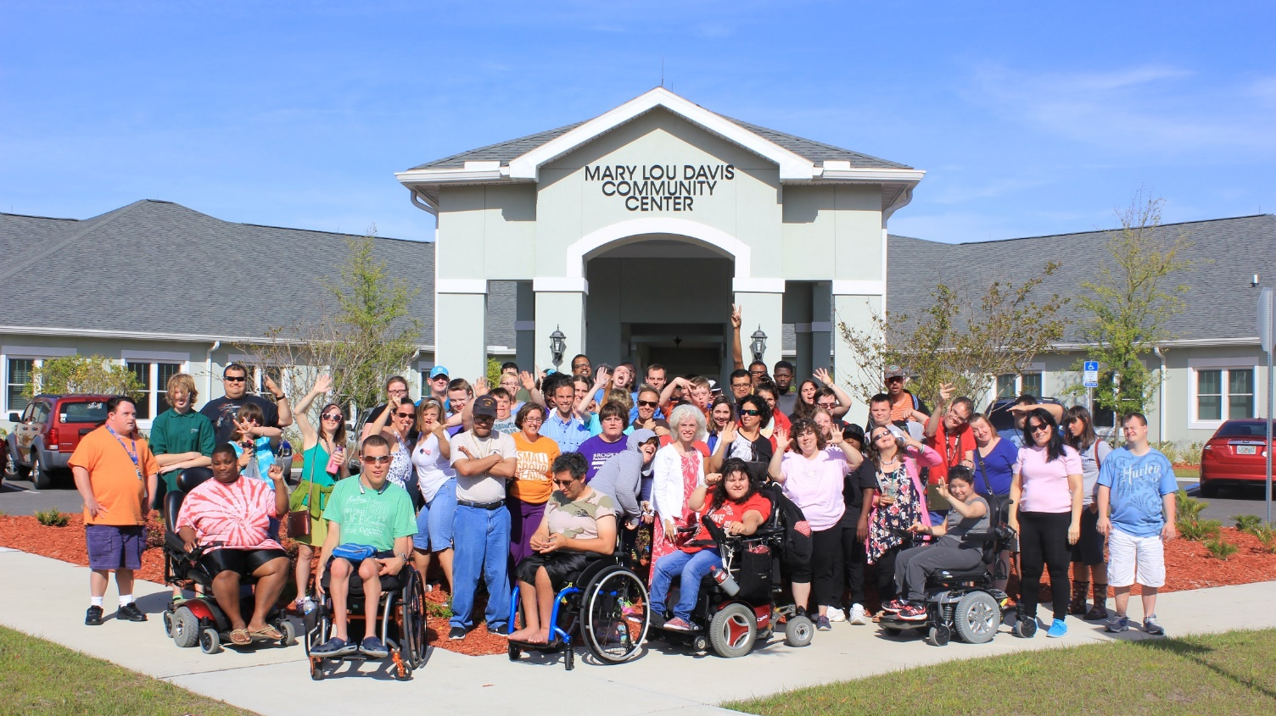
Answering “What’s Next”…..
The Arc Jacksonville Village 2016-Present
Quick Facts
Opened April 2016
100% occupied
97 apartments
121 resident bedrooms
50 Medicaid Waiver residents
50+ residents employed in community
70+ activities offered monthly
Dinner meal can be purchased
75 residents employed in the community
Amenities
Pool
Spa
Game room
Theater
Activity rooms
Dining room with stage
Commercial kitchen
Basketball court
Gardening
Gated
Security
Emergency call system

Slide 8
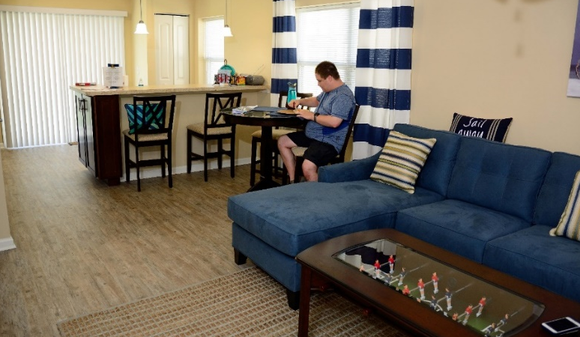
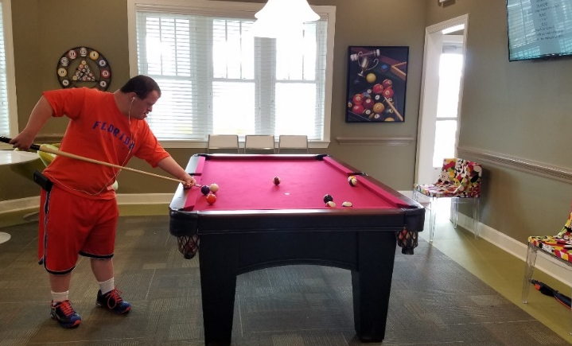
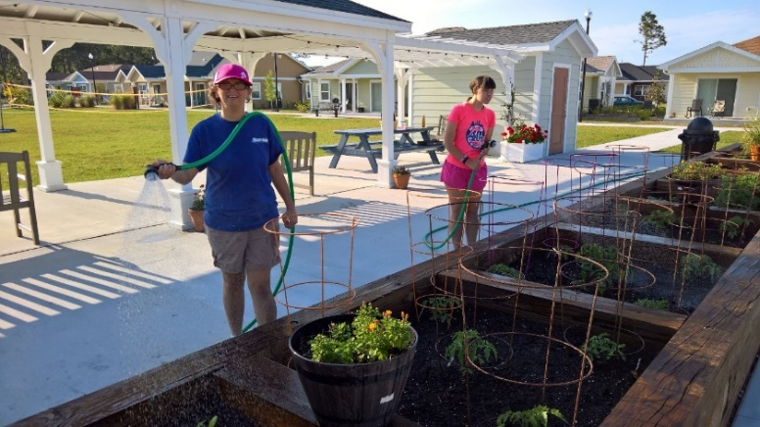
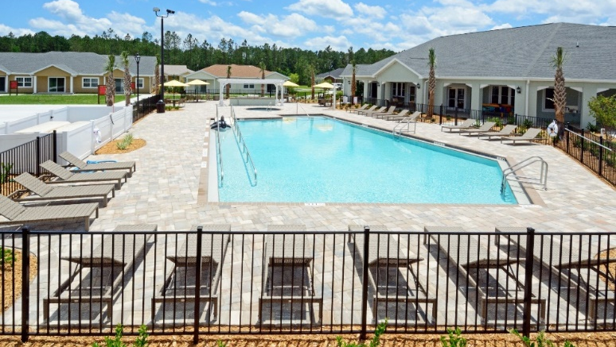
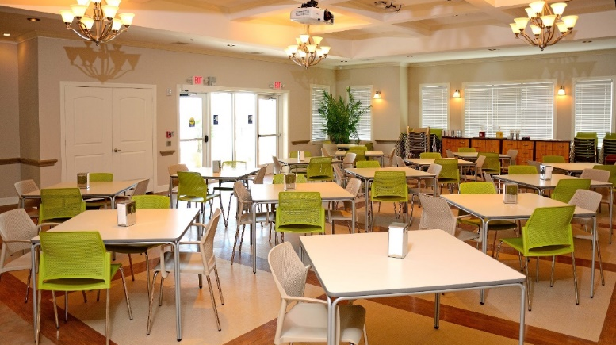
Answering “What’s Next”…..
The Arc Jacksonville Village 2016-Present

Slide 9
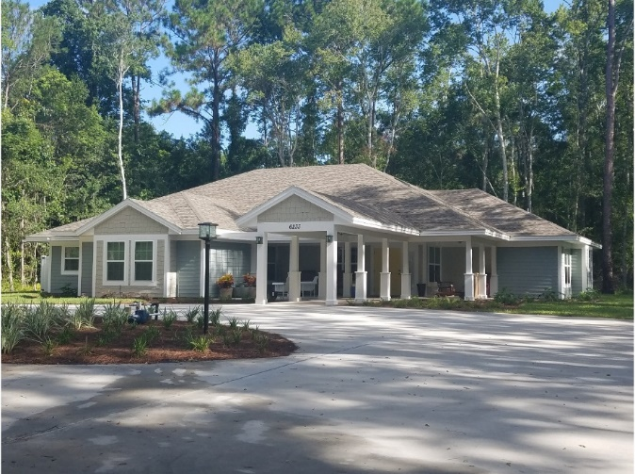
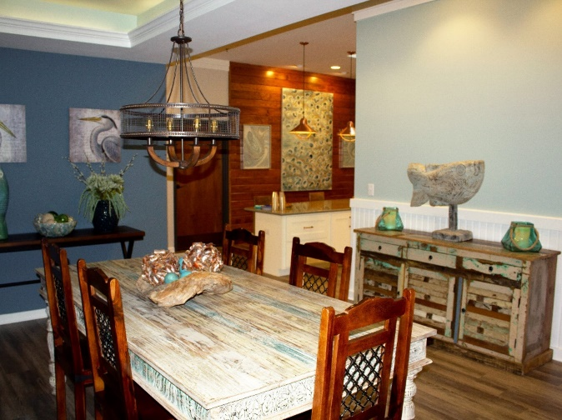
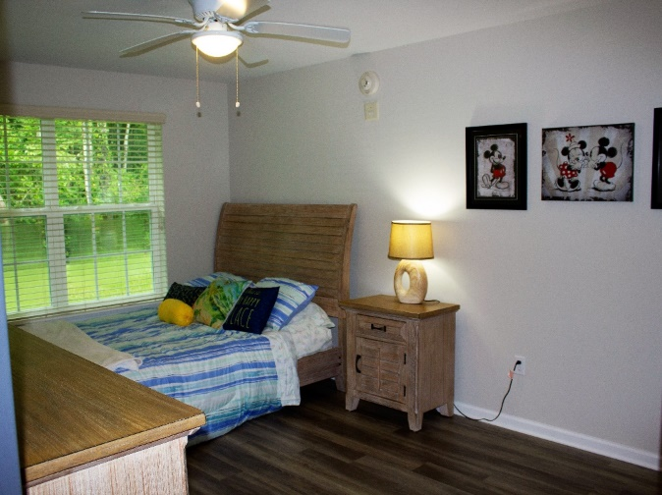
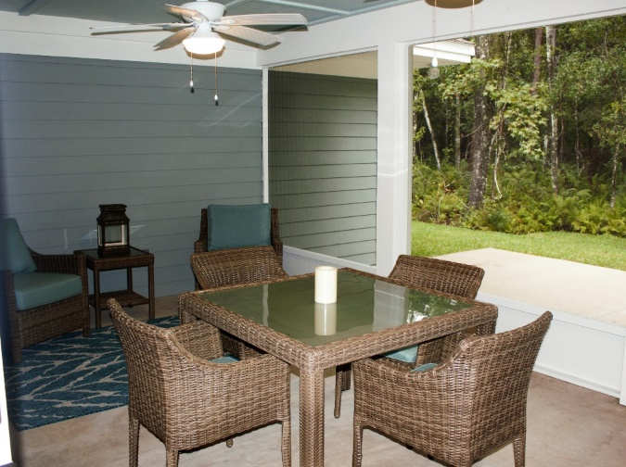
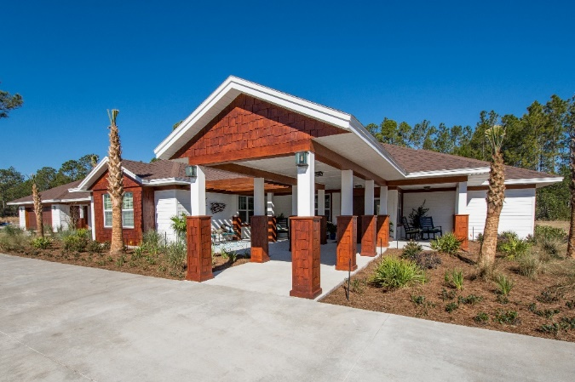
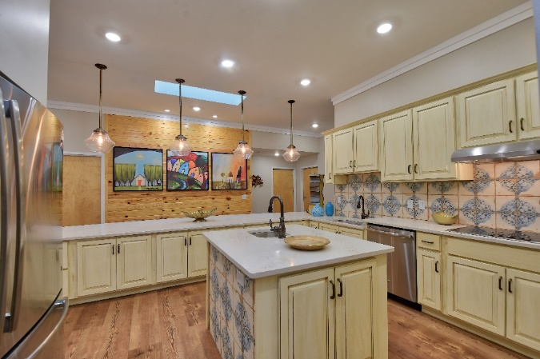
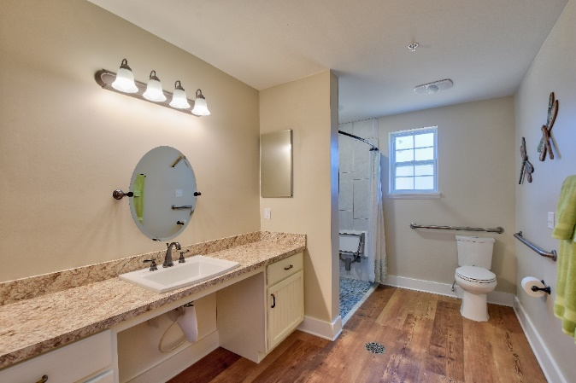
Another Choice

Slide 10
Pursuit of Best Practices
Description: | In 2017, Arc received a $300,000 legislative special appropriation. This appropriation enabled Arc to research/pilot best practices in programs and services to enhance employment preparedness and inclusion opportunities for youth (individuals under the Workforce Innovation and Opportunity Act (WIOA)), and individuals transitioning into competitive integrated employment (CIE) from facility-based work within inclusive and integrated settings.
Individuals Served: | Target Population for Pilot: 50 individuals that that fall under the following classifications: A) individuals ages 18-24 years old that desire pre-employment training with the goal of obtaining CIE; B) Individuals 25 years old and above that desire to transition from subminimum wage in facility-based workshops to CIE or desire to earn minimum wage within the facility-based workshop; and C) individuals who are 25 years old and above who are currently in a facility-based workshop who desire to transition into a program that focuses of meaningful community inclusion and life skills enhancement training Target Population to be evaluated from TI: 150
The Arc Jacksonville Annual Board and Staff Retreat | June 2018

Slide 11
Pursuit of Best Practices
The scope of work outlined in the Appropriations Project Request-Fiscal Year 2017-18 is classified into three (3) primary categories:
1) Best Practices
2) Employment
3) Community Inclusion
Each category has sub-categories that capture scope of work regarding: emotional wellbeing, enrichment of cultural experiences, and education.

Slide 12
National Trends
Best Practices Findings | Robust work readiness program, which focuses on a mixture of curricula and in-the-field experiences Use of WIOA-based VR funding streams “Dream-inspired” person-centered planning Fading out facility-based sub-minimum wage work Transition into inclusive and integrated service settings with “meaningful” experiences Transition from traditional enclaves into more inclusive small work groups Higher Medicaid Waiver rate funding rates for smaller client to staff ratios Introducing services specific to the needs of the “aging population” Higher collaboration with parent/family, guardians, and other supports (VR/Support Coordinators) in service planning/evaluation Enhanced professional development through state and national certifications Improved expectations of persons-served within services (i.e., dress, hygiene, soft-skills, etc.) Development of “club” concept for enrichment services Creation of social enterprises that are a 50/50 population (business-first model)

Slide 13
Initiatives
New Initiatives | Higher collaboration with VR leadership Certified in Peer Mentoring (completed) Discovery Assessment (in progress) Identification of un-tapped funding streams Accepted as pilot site for new Adult Services Model Development of new internship (i.e., Jumbo Shrimp, possibly Marriott) Project Discovery Curricula a career exploration and job skills curriculum for students in grades 6-12 and adults in transition. Students, of ALL ability levels, can explore many career fields and learn job skills in today’s top industries and trades found in the National Career Clusters Framework On top of soft skills training, participants receive experiential training in five employment courses; Food Service Table Service Grocery Clerking Retail Greenhouse Car Wash Culinary Program New enclave opportunities (i.e., Fields Automotive and Chartwells)

Slide 14
What’s Next for Best Practices?
Continue being a part of Arc of U.S. and Institute of Community Inclusion’s Provider Transformation Network federal research study
Continue Program & Services Board Committee to address sub-minimum wage issues
Pilot new Enrichment Program
Continue collaboration with VR and APD
Refine work readiness initiatives to increase experiential learning
Pursue social enterprise opportunities
Develop an Aging Committee to address client needs
Track data for program efficacy

Slide 15
Questions

